Slide 1
Arduino: {
BME303.html
TimYeh.css
[Temperature and Humidity Sensor]
< Group 10: Olivia McGuire, Vrunda Patel, Katherine Frazier, Daniela Lopez, Isa Bueno >
}
Group 10

Slide 2
Problem: {
01
02
03
BME303.html
TimYeh.css
Arduino and Humidity Sensor
< Use temperature/ humidity sensor to measure values from the environment and display on the 7 segment display>
Measure
< Measure the temperature for 40 seconds >
Display
}
< Display for 16 seconds, alternating between 4 sec temperature and 4 sec humidity >
Group 10

Slide 3
Temperature Sensor History;
Thermoscope
Thermometer without a scale
Galileo Galilei in 1596
Air thermometer
Santorio Santorio in 1612
Mercury thermometer
Daniel Gabriel Fahrenheit, 1716
Digital thermometer
Many different kinds invented post World War 2

Slide 4
Applications {
BME303.html
TimYeh.css
HVAC Systems
Weather Stations
The sensor can be used to measure and display atmospheric conditions
DHT11 sensor can be used to vary the AC temperature automatically based on the room’s temperature
Home automation systems
Medical purposes
The humidity sensor can be used to develop medical equipment for measuring humidity such as a ventilator.
The features of the DHT11 sensor also allow for several home applications such as fire detector using temperature and humidity or simply monitoring temperature
}
Group 10

Slide 5
Features of ‘DHT11 Sensor’ {
BME303.html
TimYeh.css
01
The DHT11 sensor uses capacitive humidity components. The capacitive sensor is made up of two metal plates and a polymer film which attracts moisture from the air and creates a voltage change when the moisture makes contact with the plates.
02
The temperature sensor consists of a thermistor that changes their resistance with temperature.
03
Operates with 4 pins: ground, input voltage of 5V, data output, non-connected pin
04
-Humidity range: 5 ~ 95% RH with accuracy of ± 5%
-Temperature range: -20 ~ 60°C with accuracy of ± 2%
}
Group 10

Slide 6
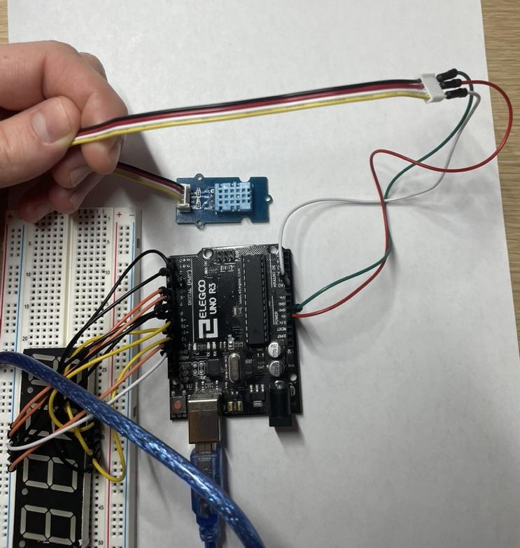
Our DHT Sensor
BME303.html
TimYeh.css
White wire
Transfers temperature and humidity signals
Red wire
Powers sensor
Green Wire
Ground

Slide 7
Contents Of ‘4 Digit Seven-Segment Display’;
BME303.html
TimYeh.css
4-digits
7 segments for each digit to display numbers
12 pins: 7 segments, one dot, and 4 digit selection pins each to select which digit will be active to display the corresponding character
Each segment in display module is multiplexed, which refers to its sharing the same anode connection points
Common cathode connection point for each of the four digits
Multiplexing allows for each digit to be turned on or off independently
Group 10

Slide 8
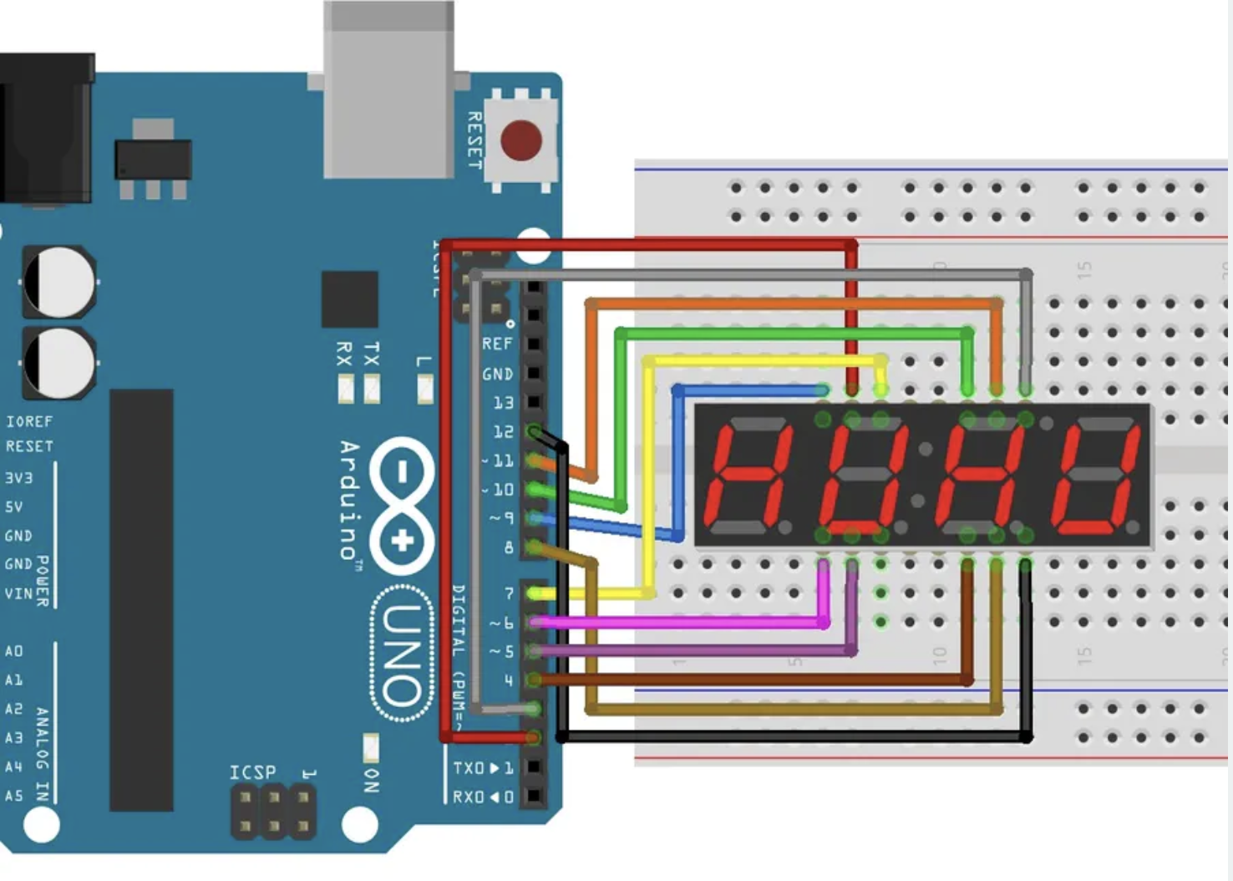
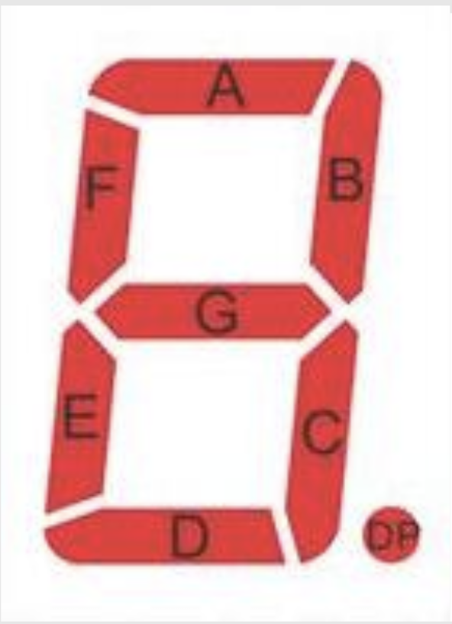

Slide 9
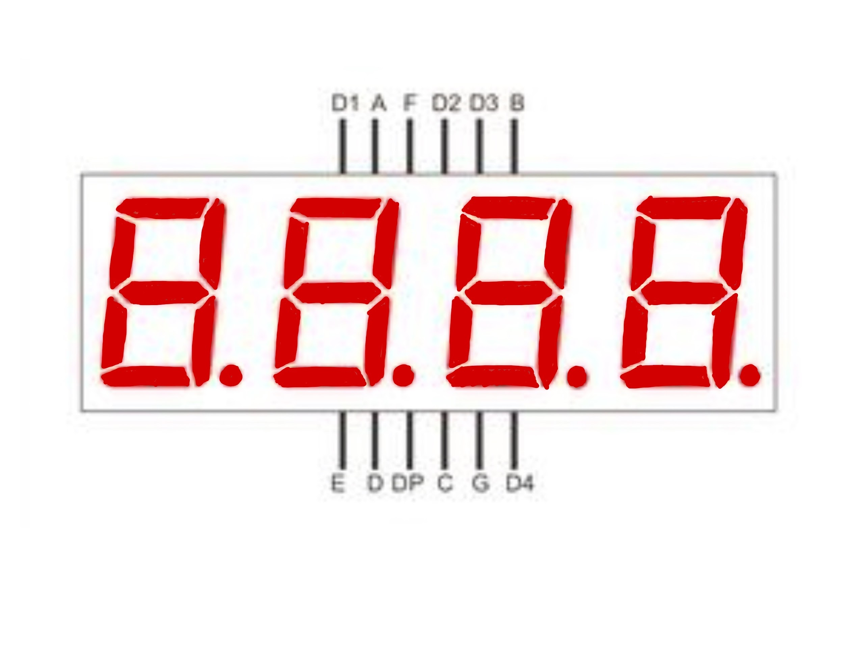

Slide 10
Our Approach {
BME303.html
TimYeh.css
Temperature and Humidity Sensor
Display
Imported DHT library
Followed sample codes
Tried to write our own display functions
Could not display proper values
SevSeg Library
Delay Function
Imported SevSeg library
Displayed proper values
Could not use delay function once the loop starts
Used millis() function
}
Group 10

Slide 11
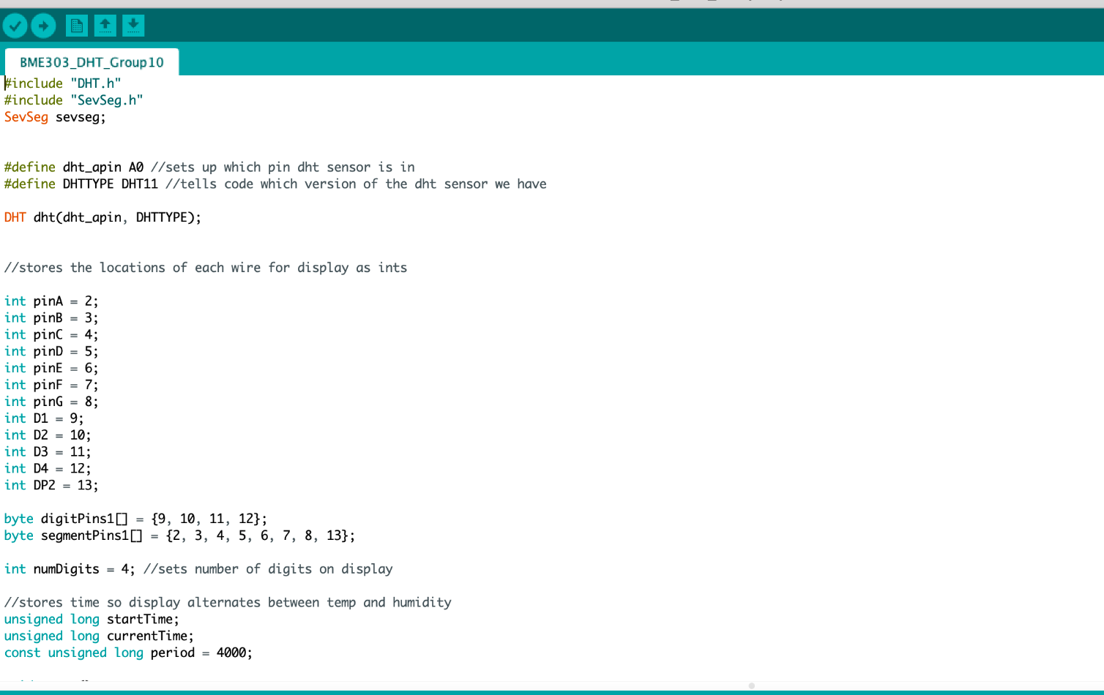
Code; {
BME303.html
TimYeh.css
}
Group 10

Slide 12
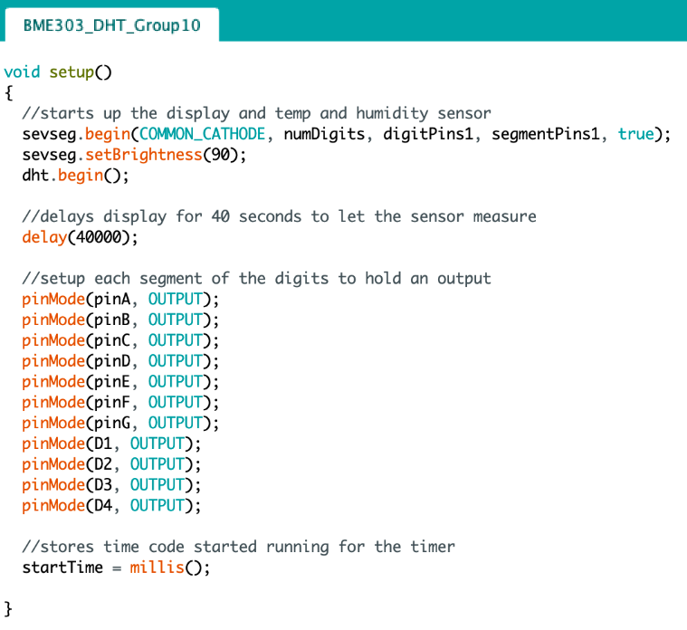
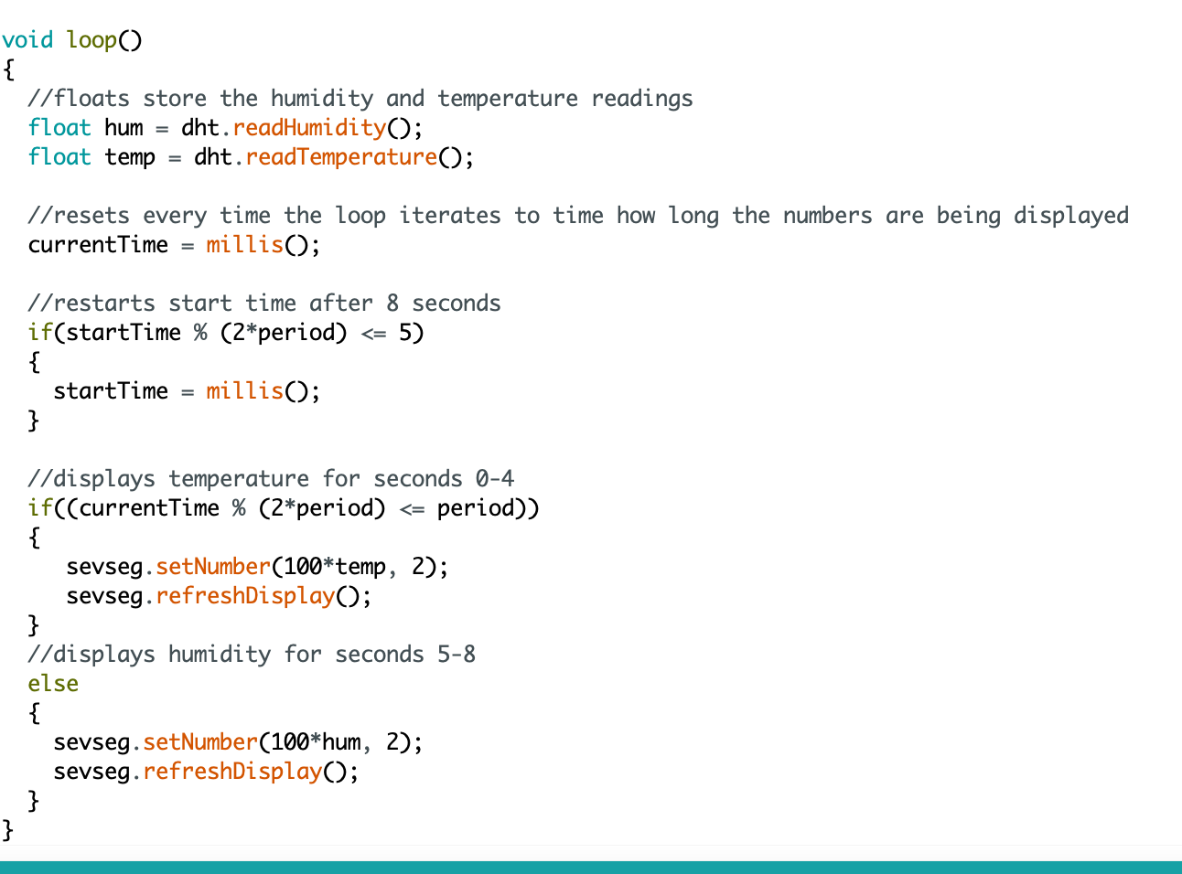
Code; {
BME303.html
TimYeh.css
}
Group 10

Slide 13

Video Demonstration of Sensor; {
BME303.html
TimYeh.css
}
Group 10

Slide 14
Hardware Challenges {
BME303.html
TimYeh.css
Arduino setup
Wiring the display
Including the decimal point in our display
}
Programming Challenges {
Alternating displaying temperature and humidity values
Displaying a singular decimal point
Timing the display with the millis() function
}
Group 10

Slide 15

Conclusion {
BME303.html
TimYeh.css
Why are temperature and humidity sensors a very important part of our world?
So we don’t show up to class dressed like this!
}
Group 10

Slide 16
Thank you for { your attention;
BME 303.html
TimYeh.css
}
Group 10

Slide 17
References:
https://www.google.com/url?q=https://circuitdigest.com/microcontroller-projects/arduino-automatic-ac-temperature-control&sa=D&source=editors&ust=1651560941019780&usg=AOvVaw12hUJqBxaUdU5kqT7dtvUT
https://www.google.com/url?q=http://www.aosong.com/en/article-22.html&sa=D&source=editors&ust=1651560941020117&usg=AOvVaw1WV0n3O1xVShtdFLWmuNvj
https://www.google.com/url?q=https://create.arduino.cc/projecthub/drpanosv/smart-home-ef269e&sa=D&source=editors&ust=1651560941020550&usg=AOvVaw1KSftUmZ8zLgrxqfubdn5c
https://www.google.com/url?q=https://www.seeedstudio.com/Grove-Temperature-Humidity-Sensor-DHT11.html?gclid%3DCjwKCAjwsJ6TBhAIEiwAfl4TWMeUBE34CFkleFrTfICyKOYbPGa-tJfDmPHcNE7xj67SzIbS0RQ3jBoCkOsQAvD_BwE&sa=D&source=editors&ust=1651560941019190&usg=AOvVaw0_eMI2SX5eLF_7j7Uvyiy_
https://www.google.com/url?q=https://create.arduino.cc/projecthub/aboda243/how-to-use-4-digit-7-segment-without-library-b8e014&sa=D&source=editors&ust=1651560941017691&usg=AOvVaw2ytSTmUONTK6W7isnCVJur
https://www.google.com/url?q=https://osoyoo.com/2017/08/08/4-digit-7-segment-led-display/&sa=D&source=editors&ust=1651560941018276&usg=AOvVaw0l8DGBdgSvw746oTlh-W1k
https://www.circuitbasics.com/arduino-thermistor-temperature-sensor-tutorial
https://www.brannan.co.uk/who-invented-the-thermometer/
https://jamaicahospital.org/newsletter/history-of-thermometers/

